Slide 1
Analyticity Team name: Lit_City PROBLEM: BANK LOAN DEFAULTER DETECTION PROBLEM software used: Ipython (jupyter notebook
TEAM MEMBERS:ABHISHEK PAUL
SIVASIS JENA

Slide 2
INTRODUCTION
The goal of the credit default detection problem is to help borrowers make better financial decisions and also to enable lenders to predict when a borrower is in financial distress and thus they can make prior arrangements to address this problem quantifiably. This can also help Investors holding stakes in securities like that of mortgage based securities to differentiate between general and sub-prime loans and thus determine the return on investment.

Slide 3
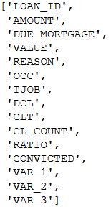
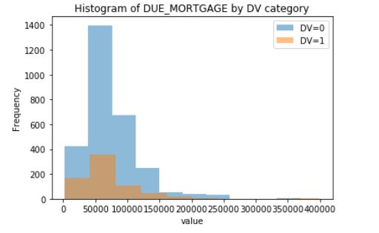
Dataset
TRAINING DATASET:
FEATURES: 14
LENGTH OF TRAINING DATASET: 3576
NUMBER OF DEFAULTERS IN DATASET: 707 (19.77%)
NUMBER OF NON-DEFAULTERS: 2869

Slide 4
The process we followed:
Data preprocessing
Exploratory Data Analysis
Feature Engineering
Model Training (CV Train data set)
Model Evaluation (Validation data set)
Calculate Cross Validation AUC
Model Fitting (Full train data)
Predict (suing Test Data)
Create Submission File

Slide 5
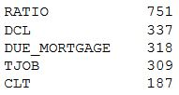
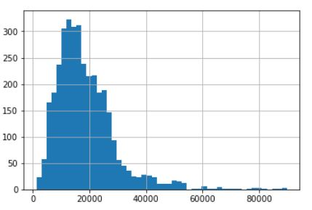
Data preprocessing, Exploratory data analysis and feature engineering
Missing data in each feature
In this initial phase:
Data preprocessing:
We stored the data into pandas DataFrame and separated the variables used for prediction from the variable to be predicted.
We imputed the missing values in the data with the medians from the data available at each column because the mean would have given outliers values in columns of binary data and also there is significant skew-ness in the data.
Exploratory data analysis:
Outlier detection with the help of Tukey IQR revealed that the ‘AMOUNT’, ‘DUE_MORTGAGE’ AND ‘VALUES’ feature had a significant number of outliers.
Instead of removing the outliers we instead normalized these features using log-normal transformation.
AMOUNT HISTOGRASM

Slide 6
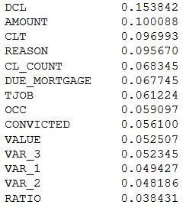
Feature engineering:
We started by doing PRINCIPAL COMPONENT ANALYSIS on the features which reduced the features from 14 to 13. Without normalizing some of the features which contained outliers, the PCA compressed the number of features to 5 but it did not give significant improvement to the models’ AUC ROC and Cross Validation score.
We ranked features according to their importance and significance.
But the models performed best when all the features were
taken into consideration.

Slide 7

MODEL SELECTION AND TRAINING
We trained our data using various classifiers. Therefore, in this phase we checked the model accuracy in 10-Fold CV and AUC ROC score. Here we have represented only the best score obtained from using or without using PCA
Logistic Regression: Trained with features obtained after PCA

Slide 8


Naïve Bayes classifier: Trained with features without PCA
Decision Tree classifier: Trained with features obtained after PCA

Slide 9

Using ensembles
Ensemble methods are learning algorithms that construct a. set of classifiers and then classify new data points by taking a (weighted) vote of their predictions. The original ensemble method is Bayesian aver- aging, but more recent algorithms include error-correcting output coding, Bagging, and boosting.
Some of the ensembles that we have used are Random forest, AdaBoost and Gradient Boosting.
Bagging and Decision Tree classifier: Trained with features without PCA

Slide 10


RandomForest classifier: Trained with features without PCA
Using model_selection and pruning at tree length=100
AdaBoost classifier: Trained with features without PCA

Slide 11


Gradient Boosting classifier: Trained with features without PCA
After parameter tuning that has been clearly mentioned in our code and taking only the top five features form feature selection ranking and using our domain knowledge in order to avoid over fitting our scores using GradientBoosting were:
From our test data the probability of getting a Defaulter was 21.057% and that a non defaulter was 78.943%

Slide 12
OBSERVATION AND MODEL SELECTION
We observed that PCA can increase model accuracy, cross validation score and AUC ROC only for simple models. It performs worse for Ensembles.
Using ensembles gives superior results both in terms of cross validation and AUC ROC. But as we can see that RandomForest classifier even after pruning at 100th branch gives 100% accuracy which is clearly indicating that its overfitting the model.
Though AdaBoost classifier performs well as compared to RandomForest, But the best CV score and without overfitting the data was exhibited by Gradient Boosting Classifier.
Also, the models performed best when all the features were taken into consideration.

